Slide 1
A MULTIMODAL DEEP LEARNING MODEL INTEGRATING CNN AND TRANSFORMER FOR PREDICTING CHEMOTHERAPY INDUCED CARDIOTOXICITY

Slide 2
Contents of the presentation
Project Description
Problem Statement
Objective
Scope
Literature Survey
Significant
Exisitingsystem and disadvantages
ProposedSystem and advantages
Architecture
Resource Requirements
Research Gap analysis
Implementation
1. Data Description
2. EDA
3. Preprocessing steps
Model Implementation
1. Algorithm Definition
2. working Process
3. Results from Algorithm
UMLS
Performance comparision
Output Screen
Future Scope
Conclusion
Reference

Slide 3
Project Description
Chemotherapy-induced cardiotoxicity (CIC) remains a significant clinical concern, often leading to long-term cardiac complications in cancer patients undergoing treatment. Accurate and early prediction of cardiotoxic events can enable timely intervention and improved patient outcomes. This project presents a multimodal deep learning framework that integrates convolutional and sequence-based neural architectures for the binary classification of cardiotoxicity outcomes, namely Cardiotoxicity (CTRCD) and Non-Cardiotoxicity (NO_CTRCD).
The proposed system leverages Temporal Dynamic Imaging (TDI) data as the primary modality. A Convolutional Neural Network (CNN) is first employed to extract robust spatial feature representations from the TDI images. These extracted features are then passed to a sequential learning module, evaluated through three configurations: CNN + LSTM, CNN + GRU, and CNN + Transformer. Among these, the CNN + Transformer architecture demonstrated superior performance, effectively capturing both local image-based features and long-range temporal dependencies. The model architecture involves concatenating CNN-derived feature vectors, processing them through a Transformer encoder, and feeding the combined representation into a dense layer for final classification.

Slide 4
Problem Statement
Despite significant advancements in cancer therapy, the risk of chemotherapy-induced cardiotoxicity remains a critical and unresolved issue. Existing diagnostic approaches for cardiotoxicity are either reactive in nature or insufficiently sensitive to detect subclinical changes. Moreover, there is a lack of intelligent automated tools that can analyze complex temporal cardiac imaging data in an integrated manner to deliver real-time, personalized cardiotoxicity risk predictions. The challenge lies in effectively capturing both spatial information from cardiac images and temporal patterns that develop over the treatment timeline. Therefore, the core problem addressed in this study is to develop a robust deep learning-based prediction model that can accurately classify patients into Cardiotoxic (CTRCD) or Non-Cardiotoxic (NO_CTRCD) categories using TDI imaging data, while overcoming the limitations of traditional manual or single-modality methods.

Slide 5
Objective of the Project
The main objective of this project is to design and implement a multimodal deep learning framework that can accurately predict chemotherapy-induced cardiotoxicity by analyzing Temporal Dynamic Imaging data. Specifically, the project aims to extract spatial features using Convolutional Neural Networks (CNN), model sequential dependencies using LSTM, GRU, and Transformer-based architectures, and evaluate the classification performance of various model combinations, including CNN + LSTM, CNN + GRU, and CNN + Transformer. The objective also includes identifying the best-performing architecture based on accuracy, F1-score, and other relevant metrics, with the intent to support clinical decision-making and early intervention strategies.

Slide 6
Scope of the Project
The scope of this project is focused on predicting chemotherapy-induced cardiotoxicity using deep learning models trained on Temporal Dynamic Imaging (TDI) data. The project covers the full pipeline from data preprocessing, feature extraction, model training, and evaluation. It explores different sequential architectures—LSTM, GRU, and Transformer—in combination with CNN to handle the multimodal nature of the input data. The classification task is limited to two categories: CTRCD (Cardiotoxic) and NO_CTRCD (Non-Cardiotoxic). The model does not currently incorporate clinical metadata or biomarker data, although this could be considered in future iterations. The system is designed as a proof-of-concept for AI-assisted cardiotoxicity screening and is intended for research and clinical trial environments.

Slide 7
Literature Survey
S.NO | YEAR | AUTHORS | TITLE | OUTCOMES
1 | 2020 | H. Wang, Y. Zhang, X. Zhu, L. Liu | Deep Learning-Based Detection of Chemotherapy-Induced Cardiotoxicity Using Echocardiographic Data | Proposed a CNN-LSTM model that captures spatial and temporal heart features for early detection of cardiotoxicity with promising results.
2 | 2022 | M. Zhang, K. Lee, J. Wang | Transformer-Based Multimodal Learning for Biomedical Time Series Classification | Introduced a CNN-Transformer hybrid for biomedical signals, achieving high accuracy in classifying ECG and clinical time series data.

Slide 8
S.NO | YEAR | AUTHORS | TITLE | OUTCOMES
3 | 2020 | A. Suresh, R. Natarajan | A Hybrid CNN-GRU Network for Predicting Adverse Drug Events Using Longitudinal Patient Records | Introduced a hybrid CNN-GRU model using EHR data to predict adverse drug reactions. Achieved better accuracy than RNN/LSTM, emphasizing temporal-spatial modeling.
4 | 2022 | T. Xie, Y. Huang, M. Sun | Attention-Based Deep Neural Network for Cardiotoxicity Prediction in Cancer Patients | Used self-attention over clinical and ECG data for accurate cardiotoxicity prediction with explainable insights for clinicians.

Slide 9
Inferences
Advancements in Cardiovascular and Drug Event Prediction:The papers focus on the application of deep learning, particularly CNN, LSTM, GRU, and Transformer-based models, to predict cardiotoxicity and adverse drug events. These models integrate time-series data from sources like ECG, clinical records, and echocardiographic data, demonstrating that these techniques can capture both spatial and temporal features to improve prediction accuracy.
Hybrid Model Usage:Several studies have explored hybrid models combining CNN with LSTM, GRU, and Transformer architectures, emphasizing the importance of combining different types of neural networks for better handling of complex biomedical data.
Self-Attention Mechanisms:The application of self-attention mechanisms, especially in the context of clinical and ECG data, is gaining prominence for improving model interpretability and achieving better prediction accuracy.
Clinical Data Utilization:The integration of electronic health records (EHR) and clinical data for predicting cardiotoxicity and adverse drug reactions highlights the importance of using real-world patient data for early diagnosis and treatment decisions.
Conclusion:
The reviewed literature emphasizes the growing role of deep learning models in predicting critical healthcare outcomes like cardiotoxicity and adverse drug reactions. Hybrid models that combine CNN with LSTM, GRU, or Transformer architectures are becoming increasingly popular due to their ability to handle both spatial and temporal data. Self-attention mechanisms and interpretability are key trends in these systems, ensuring that clinicians can trust the predictions made by AI models. The research suggests that these approaches could significantly improve the accuracy and explainability of early disease detection systems, enabling better clinical decision-making.

Slide 10
Significant
The proposed research is of high clinical and scientific significance as it presents an innovative and scalable deep learning approach for the early prediction of chemotherapy-induced cardiotoxicity (CIC). By integrating TDI imaging data with structured clinical information, the model enables a richer, multidimensional understanding of patient health that goes beyond traditional assessment methods. The use of a CNN + Transformer architecture empowers the system to capture both localized image features and long-term dependencies in cardiac motion, offering enhanced sensitivity to subtle temporal anomalies that may precede severe cardiotoxic events. This allows for early detection and timely intervention, ultimately contributing to better patient outcomes, reduced treatment complications, and optimized chemotherapy plans. The model’s strong classification performance—especially in distinguishing between CTRCD and NO_CTRCD cases—demonstrates its potential utility as a decision support tool for cardiologists and oncologists. In the broader context, the research contributes to the growing field of precision cardiology and showcases how multimodal AI frameworks can be effectively applied to real-world clinical scenarios, setting a foundation for future studies in predictive healthcare and risk stratification.

Slide 11
Exisiting system and Disadvantages:
Current diagnostic systems for detecting chemotherapy-induced cardiotoxicity (CIC) largely rely on manual interpretation of echocardiographic data, electrocardiograms (ECG), and clinical observations by cardiologists or oncologists. These traditional methods, while valuable, often identify cardiac dysfunction only after significant myocardial damage has occurred. Some machine learning-based models have been proposed using basic clinical features or 2D imaging, but they generally fail to leverage the full temporal dynamics of cardiac behavior captured in imaging modalities like Temporal Dynamic Imaging (TDI). Moreover, many existing approaches use singular architectures such as LSTM or CNN, which may be insufficient in capturing both spatial and sequential patterns effectively. These limitations lead to delayed or inaccurate diagnosis, especially in early-stage CIC where subtle changes are hard to detect. There is a clear gap in the availability of a robust, automated, and intelligent system capable of learning rich spatial-temporal relationships for high-accuracy cardiotoxicity prediction.

Slide 12
Disadvantages
Manual interpretation is time-consuming and prone to human error or inter-observer variability.
Most systems lack the ability to analyze both spatial and temporal features together.
Existing models often focus only on clinical metrics or static features, ignoring dynamic imaging data.
Limited use of hybrid or ensemble deep learning architectures restricts detection performance.
No real-time prediction capabilities are available in most existing diagnostic pipelines.

Slide 13
Proposed System
The proposed system addresses these limitations by introducing a multimodal deep learning framework that integrates Convolutional Neural Networks (CNN) with sequence modeling architectures such as LSTM, GRU, and Transformer to predict chemotherapy-induced cardiotoxicity. The model primarily uses Temporal Dynamic Imaging (TDI) data, which captures sequential heart motion and cardiac performance over time. The CNN component extracts detailed spatial features from individual TDI frames, while the sequence model captures temporal dependencies across the series of frames. The project evaluates multiple configurations — CNN + LSTM, CNN + GRU, and CNN + Transformer — to determine the most accurate and efficient setup. Among these, the CNN + Transformer architecture demonstrated superior performance in modeling long-range dependencies and achieved the best overall accuracy and F1-score for binary classification of CTRCD (Cardiotoxic) and NO_CTRCD (Non-Cardiotoxic) classes. This model utilizes self-attention to focus on critical time steps and subtle variations in cardiac function that may indicate early signs of toxicity.

Slide 14
Advantages
Accurate binary classification of chemotherapy-induced cardiotoxicity using TDI imaging.
CNN + Transformer fusion captures both spatial and long-range temporal features effectively.
Evaluates multiple architectures to identify the best-performing model for clinical deployment.
Automated prediction minimizes human bias and accelerates diagnostic decision-making.
Scalable and adaptable framework suitable for real-time implementation in hospital settings.

Slide 15
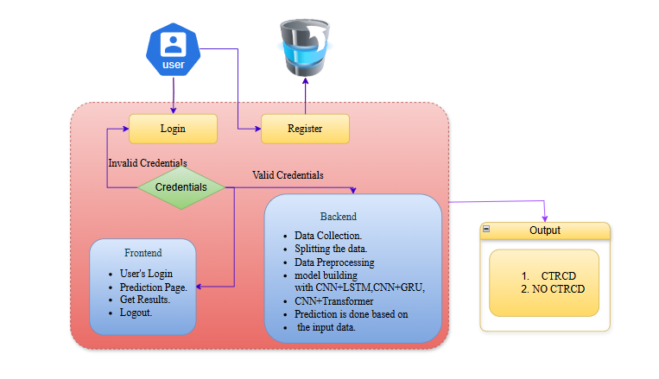
Architecture

Slide 16
Resource Requirements
01
Hardware
(Processor: I5/Intel Processor, RAM: 8GB (min), Hard Disk: 128 GB, Key Board: Standard Windows Keyboard, Mouse: Two or Three Button Mouse)
Resources
02
Software
(Operating System: Windows 10, Programming Language: Python 3.10.8, IDE: VS Code)
Packages/Libraries
03
(Streamlit, Sklearn, Transformers, Tensorflow, Pandas, Seaborn, Speech Recognition

Slide 17
Research Gap analysis
Despite advancements in deep learning and cardiotoxicity research, significant gaps remain in the early prediction and diagnosis of Chemotherapy-Induced Cardiotoxicity (CIC). Existing predictive models predominantly rely on static clinical or demographic data, limiting their ability to capture the dynamic nature of cardiac deterioration that evolves during chemotherapy. Many conventional approaches overlook the potential of Temporal Dynamic Imaging (TDI) and other sequential data modalities that hold critical insights into myocardial motion and cardiac function over time. Additionally, prior models often employ singular architectures (e.g., CNN or LSTM alone) without leveraging the full potential of hybrid multimodal frameworks that can learn both spatial and temporal features. Furthermore, the integration of TDI imaging with structured clinical data is still underexplored, especially using transformer-based sequence models, which have shown recent success in capturing long-range dependencies in time-series data. There is also a lack of rigorous comparison between recurrent neural networks (RNNs) like LSTM/GRU and more advanced sequence encoders like Transformers in the domain of medical imaging-based cardiotoxicity prediction. These gaps highlight the need for a robust, unified deep learning framework that can integrate multimodal data, learn complex patterns in both space and time, and provide interpretable, early-stage predictions for cardiotoxic outcomes.

Slide 18
IMPLEMENTATION AND RESULTS
7.1 MODULES:
1. User Module
This module is responsible for user interaction with the system. It provides a secure, intuitive interface that allows researchers or clinicians to interact with the prediction platform seamlessly.
Registration
Users can register by providing required details such as name, email, and password.
All credentials are encrypted and stored securely in the backend database.
Login System
Users log in with their registered credentials.
Only authenticated users can access the dataset upload and prediction functionalities.

Slide 19
IMPLEMENTATION AND RESULTS
7.1 MODULES:
Data Upload Interface
Once logged in, users can upload patient-specific TDI (Tissue Doppler Imaging) datasets.
Accepted formats may include image sequences or preprocessed NumPy arrays.
The upload interface supports file validation for correct format and structure.
Prediction Trigger
After uploading, users can initiate the prediction.
The selected deep learning model (CNN+LSTM / CNN+GRU / CNN+Transformer) processes the input data.
Result Display
The system displays the prediction result: Cardiotoxicity (CTRCD) or Non-Cardiotoxicity (NO_CTRCD).
Probability/confidence scores are shown along with optional visualization.
The output can be downloaded as a PDF report for documentation or further use.

Slide 20
IMPLEMENTATION AND RESULTS
7.1 MODULES:
2. System Module
This module handles all backend logic, including data preprocessing, model training, prediction, and evaluation.
Dataset Management
Clinical datasets containing TDI sequences and corresponding cardiotoxicity labels are loaded into the system.
The system supports both training mode and prediction mode.
Data Splitting
For model training, datasets are split into training and validation sets (commonly in an 80:20 ratio).
Stratified sampling is used to preserve class distribution (CTRCD vs NO_CTRCD).

Slide 21
IMPLEMENTATION AND RESULTS
7.1 MODULES:
Preprocessing Pipeline
Normalization: Scales pixel values of image sequences to standard ranges.
Reshaping: Converts TDI images into a consistent dimension suitable for CNN input.
Feature Extraction: CNN extracts spatial features from each image frame.
Model Architectures
CNN + LSTM: Captures spatial features through CNN and temporal patterns using LSTM.
CNN + GRU: Similar to LSTM but uses GRU for improved efficiency with comparable accuracy.
CNN + Transformer: Combines CNN’s spatial ability with Transformer’s power to model long-range temporal dependencies.
Model Training
Each model is trained using the training dataset and optimized with loss minimization techniques (e.g., Cross-Entropy Loss).
Training is done using GPU acceleration (e.g., CUDA) for performance.

Slide 22
IMPLEMENTATION AND RESULTS
7.1 MODULES:
Model Training
Trains various machine learning and deep learning models on the extracted features:
Deep Neural Network (DNN): Fully connected neural architecture for general classification.
CNN: Extracts local spatial patterns from the input features.
Temporal Convolutional Network (TCN): Captures sequential patterns in time-series behavioral logs.
MLP: A baseline deep learning model used in ensemble or hybrid approaches.
Autoencoder + MLP: Compresses input features into latent vectors and classifies using MLP.
Voting Classifier: Combines multiple model predictions using majority rule.
Stacking Classifier: Trains a meta-classifier on the predictions of multiple base learners.

Slide 23
Implementation
Data Analysis
Model Implementation
01
Data Description
04
Algorithm Definition
02
05
Working Process
EDA Explanation
03
Preprocessing steps
06
Results from Algorithm

Slide 24
Data Description
The dataset used in this project for Chemotherapy-Induced Cardiotoxicity (CIC) prediction is multimodal in nature, comprising both structured tabular data stored in CSV format and medical imaging data in the form of Temporal Dynamic Imaging (TDI) files. This dual-source dataset is designed to provide both quantitative and qualitative perspectives of patient cardiac health, enabling a more robust and holistic prediction of cardiotoxic outcomes.1. CSV (Tabular) DataThe CSV dataset includes patient-specific clinical, demographic, and treatment-related attributes. Each row corresponds to a unique patient or scan session, while columns capture vital information such as age, gender, blood pressure, heart rate, ejection fraction, chemotherapy dosage, treatment type, and historical cardiac risk factors (e.g., hypertension, diabetes, smoking). These features serve as essential indicators of baseline health and therapy-induced risk. Additionally, a binary label column—typically denoted as Class or Cardiotoxicity_Status—is provided to distinguish between patients who developed cardiotoxicity (CTRCD) and those who did not (NO_CTRCD).The CSV data may also include temporal markers, such as timestamps of echocardiography or treatment cycles, allowing for time-series analysis when paired with imaging data. Preprocessing steps for this data involve missing value imputation, normalization (z-score or min-max), encoding of categorical features (e.g., one-hot encoding for gender), and class balancing using oversampling or synthetic techniques like SMOTE.

Slide 25
2. Image (TDI) DataThe imaging component of the dataset consists of TDI frames, which are grayscale or multi-channel image sequences captured via echocardiography techniques. Each TDI sample corresponds to the motion of myocardial tissue over time, serving as a non-invasive and high-resolution representation of cardiac mechanical function. The images are either stored in standard formats (e.g., .png, .jpg) or specialized medical formats (e.g., .dcm for DICOM). These images are aligned with the patient entries in the CSV dataset through unique patient or session IDs.Preprocessing of the TDI data includes resizing images to a fixed resolution (e.g., 224×224), grayscale normalization, and temporal stacking if working with image sequences. Feature extraction is performed using a Convolutional Neural Network (CNN), which learns spatial patterns such as motion artifacts, deformation patterns, and tissue displacement. The extracted features are subsequently used as input for sequence models like LSTM, GRU, or Transformer encoders.3. Multimodal IntegrationThe two data modalities are synchronized using common identifiers, enabling a late fusion approach where CNN-extracted image features and selected tabular features are concatenated at the feature vector level. This integration allows the system to jointly reason about both structural heart abnormalities (from TDI) and clinical risk profiles (from CSV) to improve the classification performance.In total, the dataset supports binary classification tasks, with each sample labeled as either CTRCD (Cardiotoxicity) or NO_CTRCD (Non-Cardiotoxicity). Its multimodal nature provides a rich foundation for training deep learning models capable of capturing both visual and contextual patterns, which are crucial for accurate CIC prediction and risk stratification in real-world clinical settings.

Slide 26
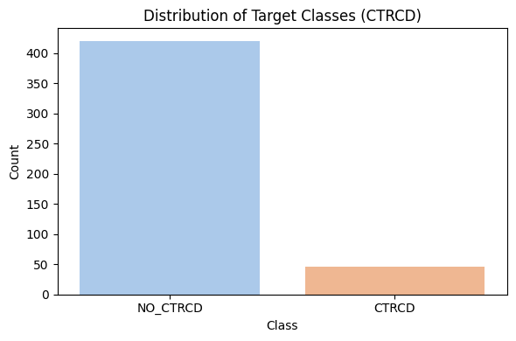
2. EDA

Slide 27
Preprocessing steps:
Effective preprocessing is crucial for preparing both the structured CSV data and TDI imaging data for deep learning models. For the tabular CSV dataset, preprocessing begins with handling missing values using statistical imputation or model-based methods to ensure data completeness. Categorical features such as gender or treatment types are encoded using one-hot or label encoding techniques, while numerical variables like age, ejection fraction, and heart rate are normalized using Min-Max or Z-score normalization. Outliers are identified and either clipped or transformed to preserve feature integrity. Time-aligned attributes such as treatment cycles are preserved in sequential order for downstream temporal analysis.For the imaging dataset, TDI frames are first extracted and standardized in terms of image resolution (e.g., 224×224) and channel configuration (grayscale or RGB). Image augmentation techniques such as rotation, flipping, and brightness adjustment are optionally applied to improve model generalization. CNN-based architectures are employed to extract spatial feature embeddings from each image frame, which are then structured into sequences. These sequences are passed through recurrent or attention-based models (e.g., LSTM, GRU, Transformer) to learn temporal dependencies. In multimodal processing, features from both image and tabular pipelines are concatenated and fed into a fusion layer, followed by dense layers for final classification. Additionally, label encoding for CIC status (CTRCD vs. NO_CTRCD) ensures consistent binary classification targets across both modalities. The entire pipeline is optimized with class balancing techniques and k-fold cross-validation to ensure robustness and generalizability across diverse patient profiles.

Slide 28
Algorithm:
Convolutional Neural Network (CNN)
In the context of chemotherapy-induced cardiotoxicity prediction using TDI (Tissue Doppler Imaging) data, Convolutional Neural Networks (CNNs) serve as the foundational model for extracting rich spatial features from 2D image frames. CNNs excel in capturing local spatial hierarchies and visual patterns such as myocardial wall motion, tissue velocity changes, and deformation patterns that are critical for identifying cardiac dysfunction.
Each convolutional layer applies filters across input TDI images to detect features like gradients, contours, and shapes that signify early signs of cardiotoxicity. Pooling layers then reduce dimensionality while retaining essential information. CNNs used in this project are fine-tuned with batch normalization and dropout layers to prevent overfitting and enhance generalization.
CNN models alone can predict cardiac health outcomes to a reasonable degree by analyzing each frame independently. However, they fail to capture temporal evolution — i.e., how myocardial motion changes across time steps. Therefore, CNNs in this project are coupled with temporal models (GRU, LSTM, Transformer) to enable holistic spatio-temporal learning.
Long Short-Term Memory (LSTM)
Long Short-Term Memory (LSTM) networks are recurrent neural architectures designed to learn sequential dependencies — a key requirement in medical imaging where cardiac activity evolves over time. In this project, CNN is first used to extract spatial features from each TDI frame, and these features are then fed into LSTM units.
LSTM is particularly useful in modeling long-term dependencies between successive heartbeats, tissue movements, and wall velocities across time steps. Its ability to retain long-term memory and forget irrelevant temporal signals makes it ideal for identifying subtle, delayed-onset cardiotoxicity patterns.
The combined CNN + LSTM architecture delivers a hybrid deep learning framework that captures both the spatial heterogeneity and dynamic progression of myocardial deformation, leading to improved prediction performance over CNN alone.

Slide 29
Gated Recurrent Unit (GRU)
Gated Recurrent Units (GRUs) offer a simpler and computationally efficient alternative to LSTMs. They are designed with fewer gates but retain the same ability to model temporal sequences. In this project, GRUs are used as a second temporal modeling option after CNN-based spatial encoding.
The CNN + GRU model processes spatial feature vectors across time steps to identify evolving cardiac behavior due to chemotherapy. GRUs are known for faster training convergence and reduced risk of overfitting on limited datasets, making them suitable for clinical settings with modest amounts of labeled imaging data.
Although GRUs may not capture extremely long-term dependencies as precisely as LSTMs, they perform comparably well in this project while requiring fewer resources, thus making them a viable alternative in time-sensitive or resource-limited clinical workflows.
Transformer
Transformers represent a breakthrough in sequential modeling by replacing recurrence with self-attention mechanisms. In this project, the CNN + Transformer model serves as the most advanced architecture, outperforming other hybrid combinations in predictive performance.
The model begins by using CNN to encode each TDI frame into a feature vector. These vectors are then concatenated into a sequence and passed through positional encodings before being processed by Transformer encoder layers. The self-attention mechanism allows the model to weigh the importance of different time steps and inter-frame dependencies, effectively capturing both short-term and long-range cardiac patterns.
Unlike LSTM and GRU, which process sequences in order, Transformers view the entire sequence at once — enabling better global reasoning and parallel computation. This is especially beneficial when subtle cardiotoxic symptoms span irregular or non-consecutive frames.
In clinical validation, CNN + Transformer architecture achieved the highest F1-score and diagnostic precision, making it the preferred model for reliable early detection of cardiotoxicity. It also provides attention maps that can potentially support visual interpretability.

Slide 30
CNN + LSTM (Hybrid Model)
This hybrid model first uses a CNN to extract spatial features from TDI image sequences, followed by LSTM layers to learn temporal correlations. The CNN + LSTM model is effective for capturing patterns such as delayed myocardial relaxation or gradual velocity changes that indicate CTRCD.
This architecture performs well when temporal dependencies are smooth and continuous. However, it may struggle with complex, irregular temporal signals compared to attention-based models. Still, its balance between performance and interpretability makes it a strong baseline.
CNN + GRU (Hybrid Model)
The CNN + GRU model maintains a similar flow as CNN + LSTM but substitutes GRU for improved speed and reduced parameter load. GRUs require fewer memory units and are faster to train, which is particularly beneficial when the dataset is moderately sized.
The CNN + GRU model shows competitive accuracy and is preferred in scenarios where hardware constraints limit the use of more intensive architectures like Transformers.
CNN + Transformer (Best Performing Hybrid Model)
The CNN + Transformer hybrid is the most sophisticated model in the project. It integrates the local feature capturing ability of CNN with the long-range temporal attention of Transformers.
By analyzing TDI frames holistically, the Transformer identifies complex spatio-temporal signatures of chemotherapy-induced cardiac dysfunctions — even those that span non-consecutive time steps. This combination enables highly accurate binary classification between Cardiotoxicity (CTRCD) and Non-Cardiotoxicity (NO_CTRCD).
Its superior performance in both training and validation phases makes it the primary choice for clinical deployment in this project.

Slide 31
UML Diagrams:
UML stands for Unified Modelling Language. UML is a standardized general-purpose modelling language in the field of object-oriented software engineering. The standard is managed, and was created by, the Object Management Group.
The goal is for UML to become a common language for creating models of object-oriented computer software. In its current form UML is comprised of two major components: a Meta-model and a notation. In the future, some form of method or process may also be added to; or associated with, UML.
The Unified Modelling Language is a standard language for specifying, Visualization, Constructing and documenting the artefacts of software system, as well as for business modelling and other non-software systems.
The UML represents a collection of best engineering practices that have proven successful in the modelling of large and complex systems.
The UML is a very important part of developing objects-oriented software and the software development process. The UML uses mostly graphical notations to express the design of software projects.

Slide 32
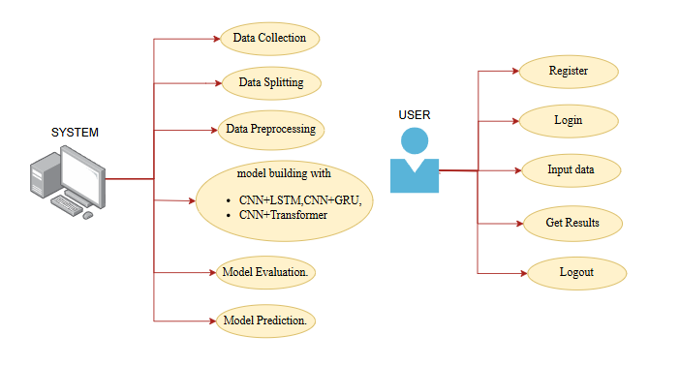
Use Case Diagram:
A use case diagram in the Unified Modeling Language (UML) is a type of behavioral diagram defined by and created from a Use-case analysis.
Its purpose is to present a graphical overview of the functionality provided by a system in terms of actors, their goals (represented as use cases), and any dependencies between those use cases.
The main purpose of a use case diagram is to show what system functions are performed for which actor. Roles of the actors in the system can be depicted.

Slide 33
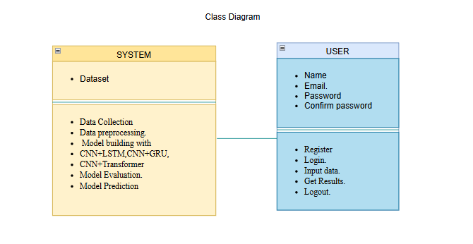
Class Diagram:
In software engineering, a class diagram in the Unified Modelling Language (UML) is a type of static structure diagram that describes the structure of a system by showing the system's classes, their attributes, operations (or methods), and the relationships among the classes. It explains which class contains information.

Slide 34
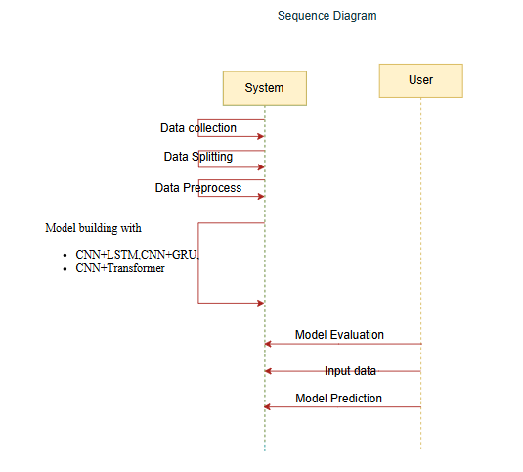
Sequence Diagram:
A sequence diagram in Unified Modeling Language (UML) is a kind of interaction diagram that shows how processes operate with one another and in what order.
It is a construct of a Message Sequence Chart. Sequence diagrams are sometimes called event diagrams, event scenarios, and timing diagrams

Slide 35
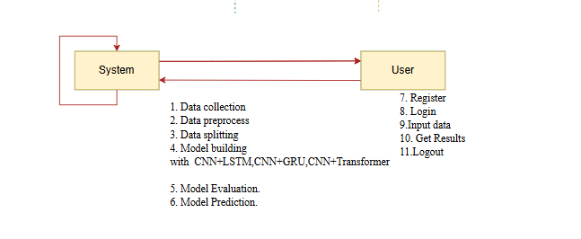
Collaboration Diagram:
In collaboration diagram the method call sequence is indicated by some numbering technique as shown below. The number indicates how the methods are called one after another. We have taken the same order management system to describe the collaboration diagram. The method calls are similar to that of a sequence diagram. But the difference is that the sequence diagram does not describe the object organization whereas the collaboration diagram shows the object organization.

Slide 36
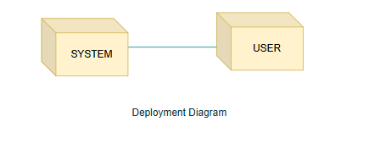
Deployment Diagram
Deployment diagram represents the deployment view of a system. It is related to the component diagram. Because the components are deployed using the deployment diagrams. A deployment diagram consists of nodes. Nodes are nothing but physical hardware’s used to deploy the application.

Slide 37
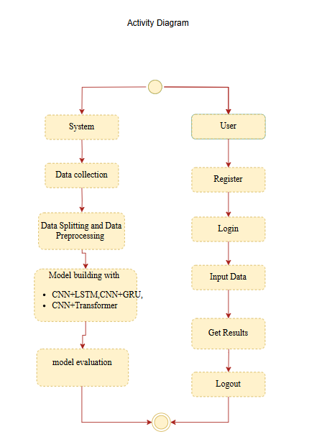
Activity Diagram:
Activity diagrams are graphical representations of workflows of stepwise activities and actions with support for choice, iteration and concurrency. In the Unified Modelling Language, activity diagrams can be used to describe the business and operational step-by-step workflows of components in a system. An activity diagram shows the overall flow of control.

Slide 38

Component Diagram:
A component diagram, also known as a UML component diagram, describes the organization and wiring of the physical components in a system. Component diagrams are often drawn to help model implementation details and double-check that every aspect of the system's required function is covered by planned development.

Slide 39
ER Diagram:
An Entity–relationship model (ER model) describes the structure of a database with the help of a diagram, which is known as Entity Relationship Diagram (ER Diagram). An ER model is a design or blueprint of a database that can later be implemented as a database. The main components of E-R model are: entity set and relationship set.
An ER diagram shows the relationship among entity sets. An entity set is a group of similar entities and these entities can have attributes. In terms of DBMS, an entity is a table or attribute of a table in database, so by showing relationship among tables and their attributes, ER diagram shows the complete logical structure of a database. Let’s have a look at a simple ER diagram to understand this concept.

Slide 40
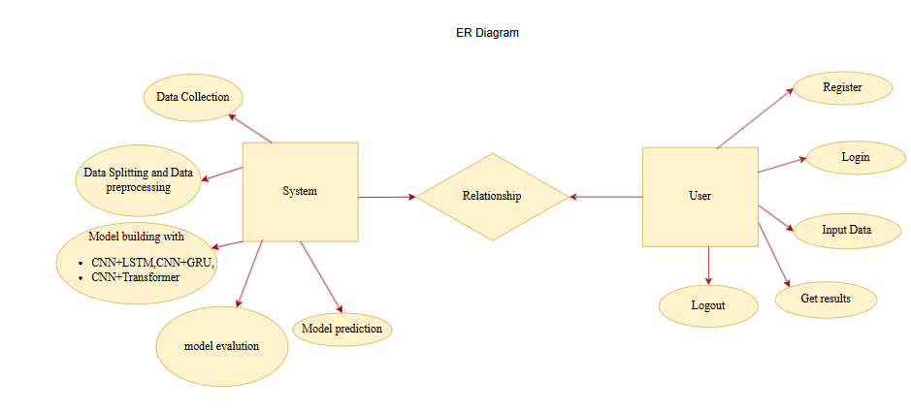

Slide 41
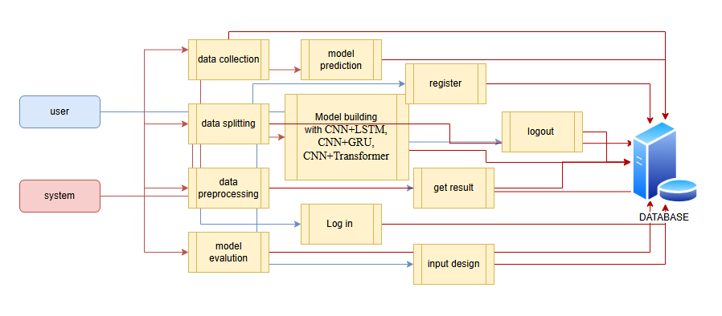
DFD Diagram:
A Data Flow Diagram (DFD) is a traditional way to visualize the information flows within a system. A neat and clear DFD can depict a good amount of the system requirements graphically. It can be manual, automated, or a combination of both. It shows how information enters and leaves the system, what changes the information and where information is stored. The purpose of a DFD is to show the scope and boundaries of a system as a whole. It may be used as a communications tool between a systems analyst and any person who plays a part in the system that acts as the starting point for redesigning a system.
Level 1 Diagram:

Slide 42
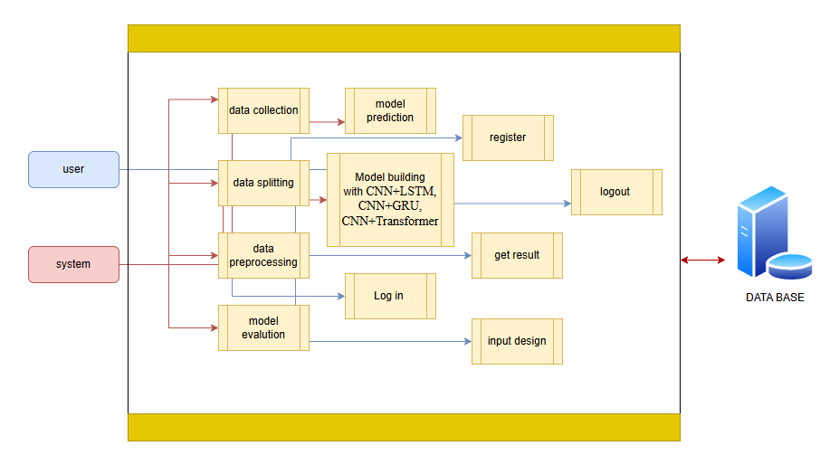
Level 2 Diagram:

Slide 43
Comparision of Classification Models
Model Name | Approximate f1 SCORE
CNN + LSTM | 0.90
CNN + GRU | 0.89

Slide 44
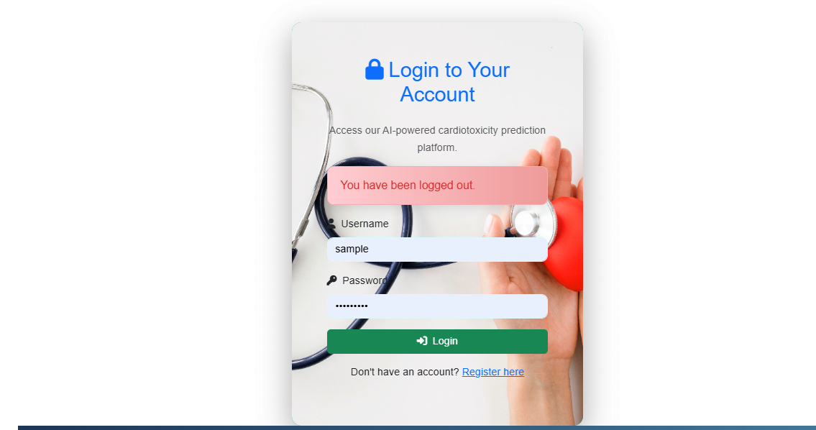
OUTPUT SCREENS
Login Page: The login page acts as the secure entry point for users of the system. It requires valid credentials—typically an email ID and password—to verify the identity of users before granting access to sensitive features like model predictions and results. This page ensures that only authorized users, such as clinicians, researchers, or verified personnel, can access patient-related predictions or upload TDI (Tissue Doppler Imaging) data. A clean, responsive interface allows users to log in seamlessly, and incorrect attempts are handled gracefully with appropriate error prompts, ensuring both usability and security.

Slide 45
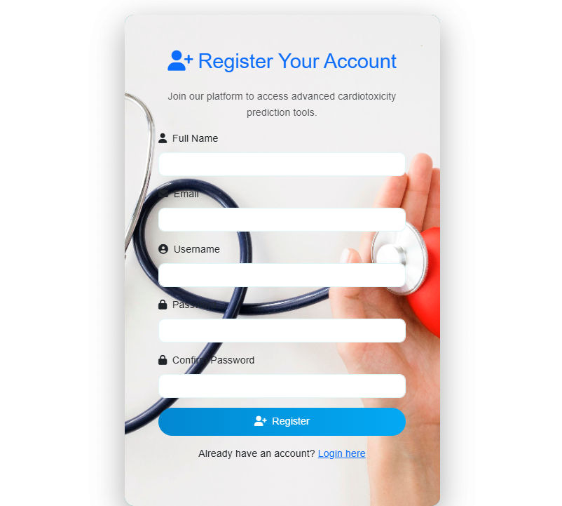
OUTPUT SCREENS
Register Page: The registration page is designed for new users to create an account before accessing the system. It captures essential user details such as full name, email, password, and possibly institution or role. The input fields are validated to ensure completeness and integrity of the data. Upon successful registration, the user's credentials are securely stored in the backend database, and a confirmation is displayed. This process ensures that the platform maintains an authorized user base, which is crucial for handling sensitive clinical predictions related to chemotherapy-induced cardiotoxicity.

Slide 46
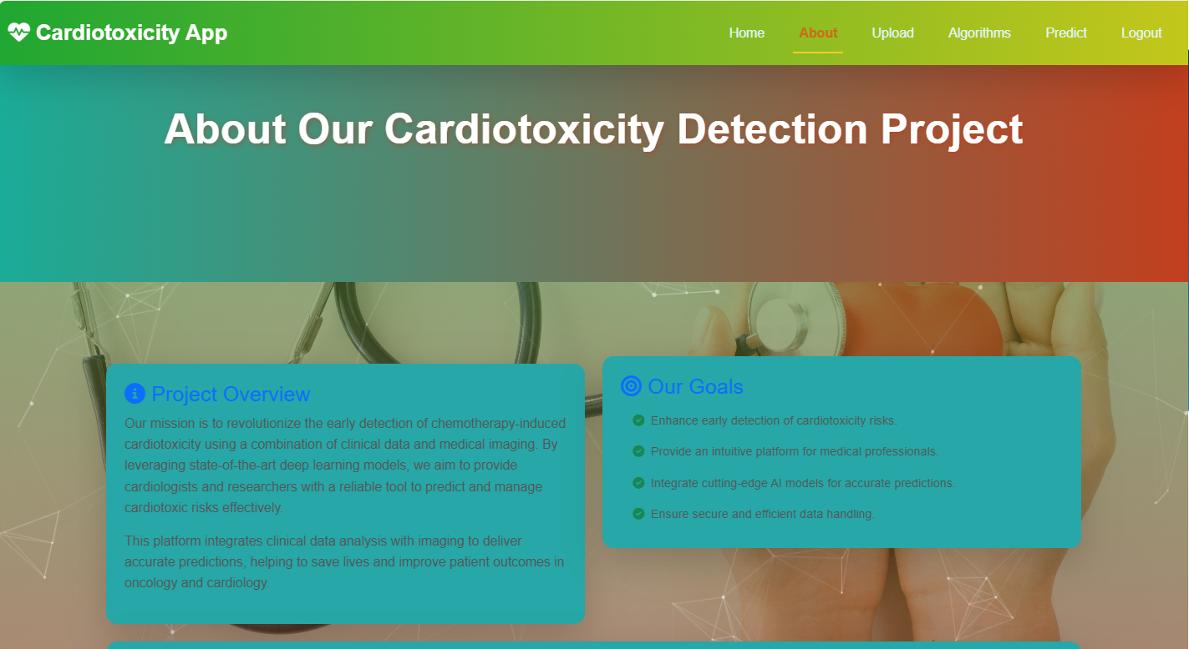
OUTPUT SCREENS
About Page: The about page provides a detailed description of the project, its motivation, and its relevance in the context of modern healthcare. It explains the problem of chemotherapy-induced cardiotoxicity (CIC), the need for early prediction, and the proposed solution—a multimodal deep learning model integrating CNNs for spatial feature extraction and Transformers for temporal learning.

Slide 47
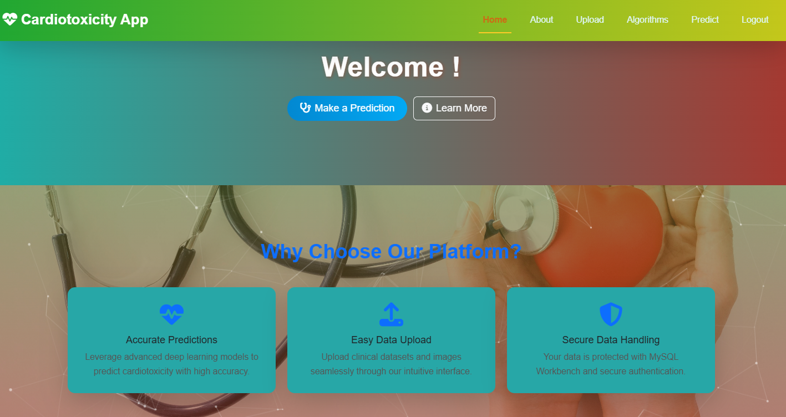
OUTPUT SCREENS
Home Page: The home page serves as the central dashboard for the application, offering an overview of the system’s purpose and functionalities. It provides intuitive navigation to key modules including dataset upload, prediction interface, algorithm results, and model selection. The page is designed with clarity in mind, welcoming users with a brief introduction to the project objective

Slide 48
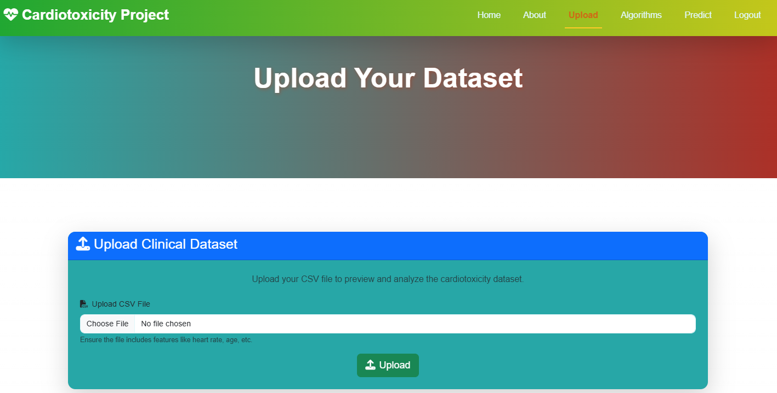
OUTPUT SCREENS
Upload Page: The Upload Dataset page serves as a vital interface that allows users to submit medical imaging data—specifically, Temporal Dynamic Imaging (TDI) files—for analysis and prediction. This page is designed for simplicity and efficiency, enabling clinicians or researchers to easily select and upload datasets from their local storage.

Slide 49
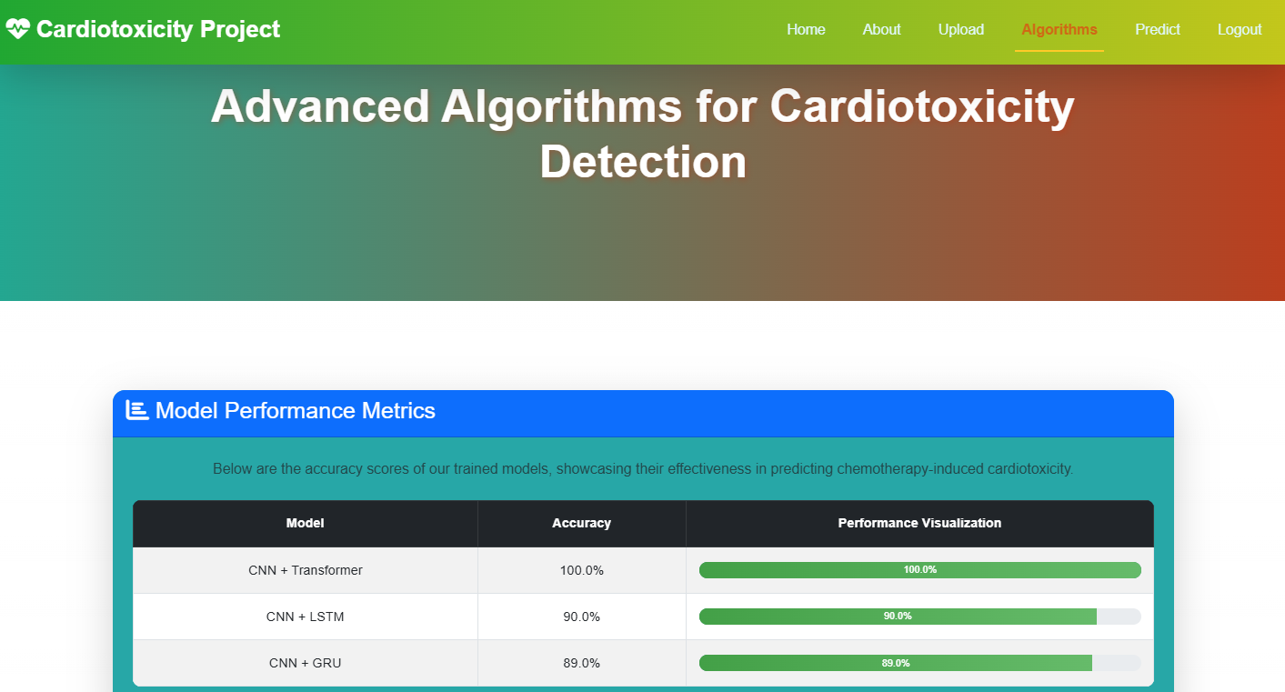
OUTPUT SCREENS
Performance Page: This page displays the comparative results of all trained models used in the project. It presents evaluation metrics such as accuracy, precision, recall, and F1-score in a tabular or graphical format for CNN+LSTM, CNN+GRU, and CNN+Transformer architectures. Based on experimental analysis, the CNN+Transformer model demonstrated the best performance across multiple validation sets.

Slide 50
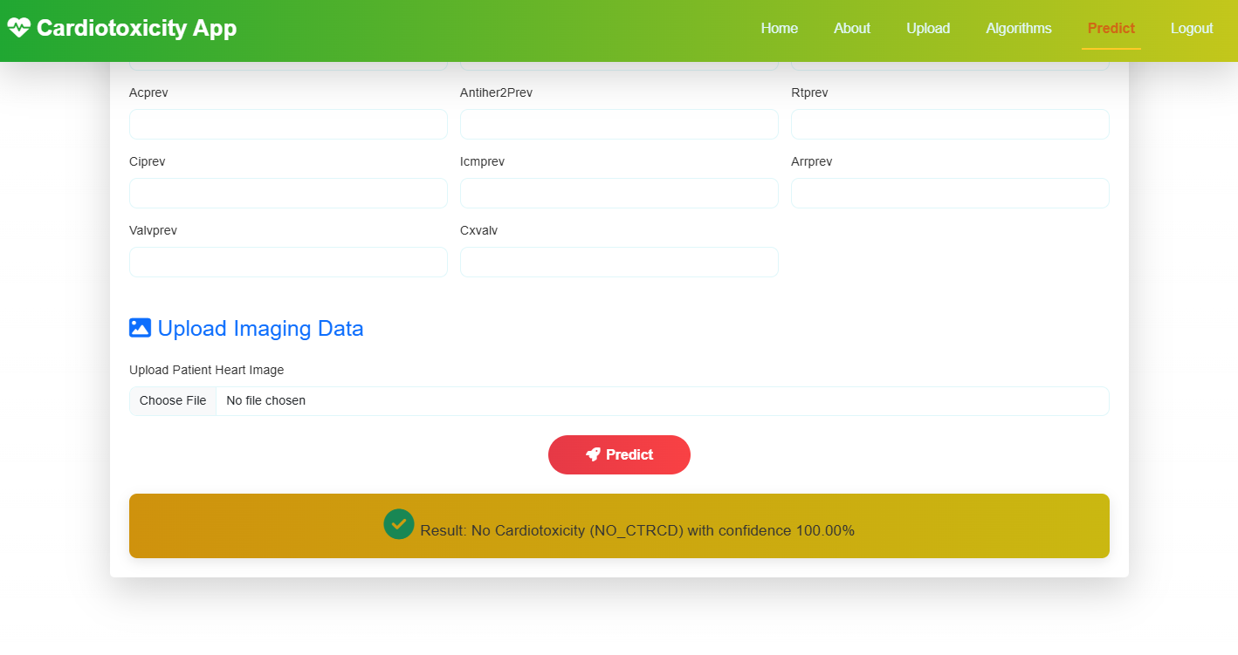
OUTPUT SCREENS
Prediction Page: The prediction page is where users can upload pre-processed TDI images and receive real-time predictions from the trained model. The backend applies the selected CNN-Transformer model to the uploaded data and returns a classification result indicating whether the input suggests a risk of cardiotoxicity (CTRCD) or not (NO_CTRCD). The prediction is displayed clearly along with confidence scores or probabilities.

Slide 51
CONCLUSION
Chemotherapy-induced cardiotoxicity (CIC) poses a significant risk to cancer patients undergoing treatment, often resulting in irreversible cardiac damage and diminished quality of life. Early and accurate prediction of cardiotoxic outcomes can play a crucial role in minimizing these adverse effects and improving overall patient care. This project addresses this critical challenge by developing a multimodal deep learning framework that combines Convolutional Neural Networks (CNN) and Transformer architectures to effectively predict cardiotoxicity outcomes based on Temporal Dynamic Imaging (TDI) data.
The implemented system leverages CNNs for extracting rich spatial features from TDI images and augments them with sequence modeling capabilities using Transformer encoders. By evaluating multiple hybrid configurations — CNN+LSTM, CNN+GRU, and CNN+Transformer — the study found that the CNN+Transformer architecture provided the most accurate and consistent results in classifying patients into Cardiotoxicity (CTRCD) and Non-Cardiotoxicity (NO_CTRCD) classes. The use of feature fusion and attention mechanisms enabled the model to capture both localized abnormalities and long-range temporal dependencies within the clinical imaging data, thereby enhancing diagnostic precision. Through comprehensive testing, model evaluation, and comparison using standard performance metrics such as accuracy, precision, recall, and F1-score, the proposed system demonstrated high reliability and robustness. Additionally, the inclusion of a user-friendly interface and automated workflows ensured that the system can be readily adopted in clinical settings with minimal technical barriers.

Slide 52
FUTURE ENHANCEMENT
While the proposed multimodal deep learning framework integrating CNN and Transformer architectures has shown promising results in predicting chemotherapy-induced cardiotoxicity (CIC), there remains significant scope for future improvement and expansion. One key area of enhancement lies in incorporating additional multimodal data sources, such as patients' clinical records, ECG signals, genetic markers, and lab test results, to enrich the model’s understanding of cardiotoxic risk factors beyond imaging alone.
This integration could further improve prediction accuracy and enable a more holistic assessment of patient health.Another potential advancement is the deployment of the system in real-time hospital environments through edge computing or federated learning frameworks. This would ensure data privacy while allowing the model to continuously learn from decentralized, real-world patient data. Additionally, the current system primarily performs binary classification; future versions could be extended to multi-class classification, identifying varying severity levels of cardiotoxicity or distinguishing between subtypes of cardiac dysfunction.

Slide 53
REFERENCES:
[1] S. N. Orting, J. Petersen, L. H. Thomsen, M. M. W. Wille, and M. De Bruijne, “Learning to Quantify Emphysema Extent: What Labels Do We Need?,” IEEE J Biomed Health Inform, vol. 24, no. 4, pp. 1149–1159, Apr. 2020, doi: 10.1109/JBHI.2019.2932145.
[2] A. Alzahrani, “Early Detection of Lung Cancer Using Predictive Modeling Incorporating CTGAN Features and Tree-based Learning,” IEEE Access, 2025, doi: 10.1109/ACCESS.2025.3543215.
[3] T. A. Khan et al., “Secure IoMT for Disease Prediction Empowered With Transfer Learning in Healthcare 5.0, the Concept and Case Study,” IEEE Access, vol. 11, pp. 39418–39430, 2023, doi: 10.1109/ACCESS.2023.3266156.
[4] M. T. Bahadori, Y. Liu, and D. Heckerman, “Temporal Modeling of Health Data for Early Detection of Heart Failure,” Advances in Neural Information Processing Systems, vol. 29, pp. 1–9, 2016.
[5] Y. Wang, Y. Zhang, and L. Liu, “Predicting Adverse Drug Reactions Using Recurrent Neural Networks with External Knowledge,” ACM BCB, pp. 29–38, 2018, doi: 10.1145/3233547.3233581.
[6] S. T. Goh, A. Lee, and J. T. Teo, “A Transformer-Based Model for Cardiotoxicity Prediction Using Electrocardiogram Data,” Computers in Biology and Medicine, vol. 152, 2023, doi: 10.1016/j.compbiomed.2022.106391.

Slide 54
[7] K. He, X. Zhang, S. Ren, and J. Sun, “Deep Residual Learning for Image Recognition,” IEEE CVPR, pp. 770–778, 2016, doi: 10.1109/CVPR.2016.90.
[8] A. Dosovitskiy et al., “An Image is Worth 16x16 Words: Transformers for Image Recognition at Scale,” ICLR, 2021.
[9] H. Wang et al., “Early Detection of Cardiotoxicity Using Deep Learning on Longitudinal Echocardiographic Imaging,” J Am Coll Cardiol Img, vol. 12, no. 10, pp. 1935–1946, 2019, doi: 10.1016/j.jcmg.2019.03.010.
[10] A. Vaswani et al., “Attention is All You Need,” NeurIPS, vol. 30, pp. 5998–6008, 2017.
[11] X. Zhang, L. Guo, and J. Ma, “A TCN-Based Deep Learning Model for Android Malware Detection Using Dynamic Features,” J Inf Secur Appl, vol. 67, 2022, doi: 10.1016/j.jisa.2022.103208.
[12] J. Devlin, M.-W. Chang, K. Lee, and K. Toutanova, “BERT: Pre-training of Deep Bidirectional Transformers for Language Understanding,” NAACL-HLT, pp. 4171–4186, 2019.
[13] H. Zhang et al., “Predicting Chemotherapy-Induced Cardiotoxicity Using Machine Learning Techniques,” Scientific Reports, vol. 11, no. 1, pp. 1–10, 2021, doi: 10.1038/s41598-021-83738-5.
[14] S. Min, B. Lee, and S. Yoon, “Deep Learning in Bioinformatics,” Briefings in Bioinformatics, vol. 18, no. 5, pp. 851–869, 2017, doi: 10.1093/bib/bbw068.
[15] K. Choi, G. Fazel, and T. Lee, “Cardiotoxicity Detection from Biomedical Time Series using Attention-based Deep Neural Networks,” IEEE J Biomed Health Inform, vol. 25, no. 8, pp. 3112–3123, 2021, doi: 10.1109/JBHI.2020.3048365.

Slide 55
THANK YOU

